Slide 1

Introduction To Numpy
Complete Guide

Slide 2
What You Will Learn After Completing This Section :-
Installation Of NumPy
Basics Of NumPy array
Array :- Slicing, Reshaping and Indexing
Arithmetic Operation Of 2d array
Covariance, Correlation and Linear Regression

Slide 3
Installation Of Numpy
pip install numpy
1.16.3

Slide 4
Basics Of NumPy Array
NumPy is a Python library that can be used for scientific and numerical applications and is the tool to use for linear algebra operations.
The main data structure in NumPy is the ndarray, which is a shorthand name for N-dimensional array. When working with NumPy, data in an ndarray is simply referred to as an array.
It is a fixed-sized array in memory that contains data of the same type, such as integers or floating point values.
The data type supported by an array can be accessed via the “dtype” attribute on the array. The dimensions of an array can be accessed via the “shape” attribute that returns a tuple describing the length of each dimension.

Slide 5
Functions To Create NumPy Array
array() :- Create n-dimensional user defined array
empty() :- will create a new array of the specified shape.
zeros() :- will create a new array of the specified size with the contents filled with zero values.
Ones() :- will create a new array of the specified size with the contents filled with one values.

Slide 6
Array Reshape
NumPy provides the reshape() function on the NumPy array object that can be used to reshape the data.
The reshape() function takes a single argument that specifies the new shape of the array.

Slide 7
Array Indexing
Once your data is represented using a NumPy array, you can access it using indexing
In One Dimensional Array you can access elements using the bracket operator [] specifying the zero-offset index for the value to retrieve
Indexing two-dimensional data is similar to indexing one-dimensional data, except that a comma is used to separate the index for each dimension.

Slide 8
Array Slicing
Slicing is specified using the colon operator ‘:’ with a ‘from‘ and ‘to‘ index before and after the column respectively. The slice extends from the ‘from’ index and ends one item before the ‘to’ index.
Data[from:to]

Slide 9
Arithmetic Operations on Array
Input arrays for performing arithmetic operations such as add(), subtract(), multiply(), and divide() must be either of the same shape or should conform to array broadcasting rules.

Slide 10
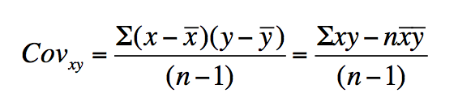
Covariance

Slide 11
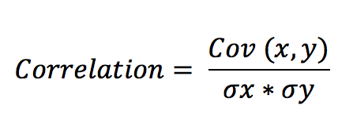
Correlation

Slide 12
Linear Regression
Linear regression is a statistical approach for modelling relationship between a dependent variable with a given set of independent variables.
Y = mX + b

Slide 13

Quick Numpy Exercise

